Slide 1
Bellabeat Data Analysis Case Study How can a wellness technology company play it smart?
Kunal Barthwal
June 04, 2023

Slide 2
Project analysis slide 3
Table of Contents
INTRODUCTION
PURPOSE STATEMENT
ANALYSIS
CONCLUSION
APPENDIX
Brief summary about Fitness Trackers in the Healthcare Sector
What are we talking about?
What is our data trying to convey?
What did we discover from our data?
Additional Information

Slide 3
Project analysis slide 10
Introduction
In 2020, North America held the highest revenue share of more than 42% owing to the rise in awareness and adoption of fitness trackers. Moreover, rising cases of health issues related to sedentary lifestyles, the advent of innovative products by key market players, and the growing penetration of smartphones and the internet in North America will drive the regional industry.
On the other hand, Asia Pacific is expected to be the fastest-growing regional market from 2021 to 2028 on account of the high adoption of fitness trackers and growing awareness regarding overall health & fitness among the working-class population.
The global fitness tracker market size to be valued at USD 138.7 billion by 2028 and is expected to grow at a compound annual growth rate (CAGR) of 18.9% during the forecast period.
Arise in the number of manufacturers offering various fitness trackers at prices suitable for all income groups is driving the market. In addition, the development of different types of wearables, such as smart jewelry, insoles, and clothing, is attracting more consumers.

Slide 4
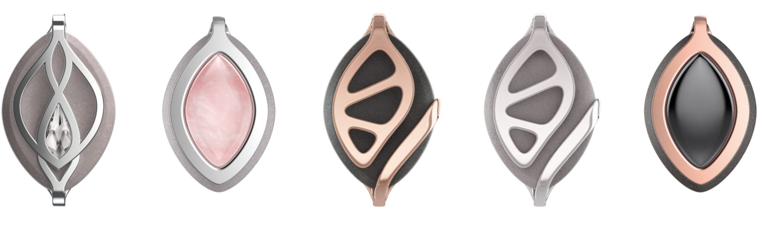
Project analysis slide 3
Purpose Statement
Business Task
Analyze smart device user data in order to gain insights into how customers use non-Bellabeat smart devices. Then, we will apply these insights to Bellabeat Leaf.
Company Information
Bellabeat is a wellness company founded by Urška Sršen and Sandro Mur in 2014. It is best known for its Leaf smart jewelry wearable line. The company has offices in San Francisco, Zagreb and Hong Kong.
Key Stakeholders
Urška Sršen - Bellabeat’s co-founder and Chief Creative Officer
Sando Mur - Bellabeat’s co-founder and key member of the executive team
Bellabeat Marketing Analytics Team

Slide 5
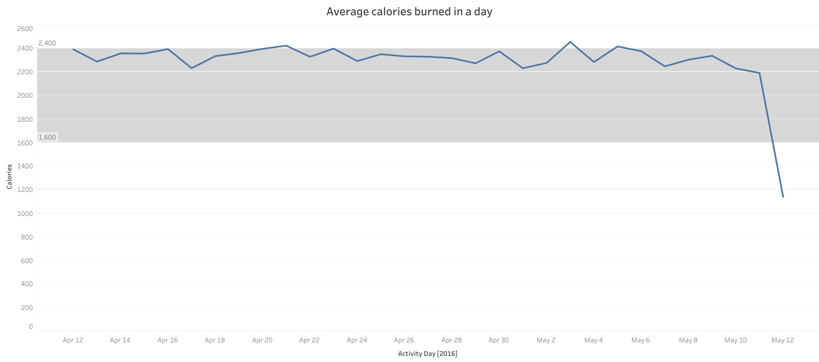
Project analysis slide 5
Analysis
Data
Study
Trend
The above line graph depicts the average calories burned by individuals in a day
According to dietary guidelines for Americans (2020-25), the average adult woman expends roughly 1600-2400 calories per day
A feature can be added to the Bellabeat app for daily calorie target so that individuals can keep track of their progress

Slide 6
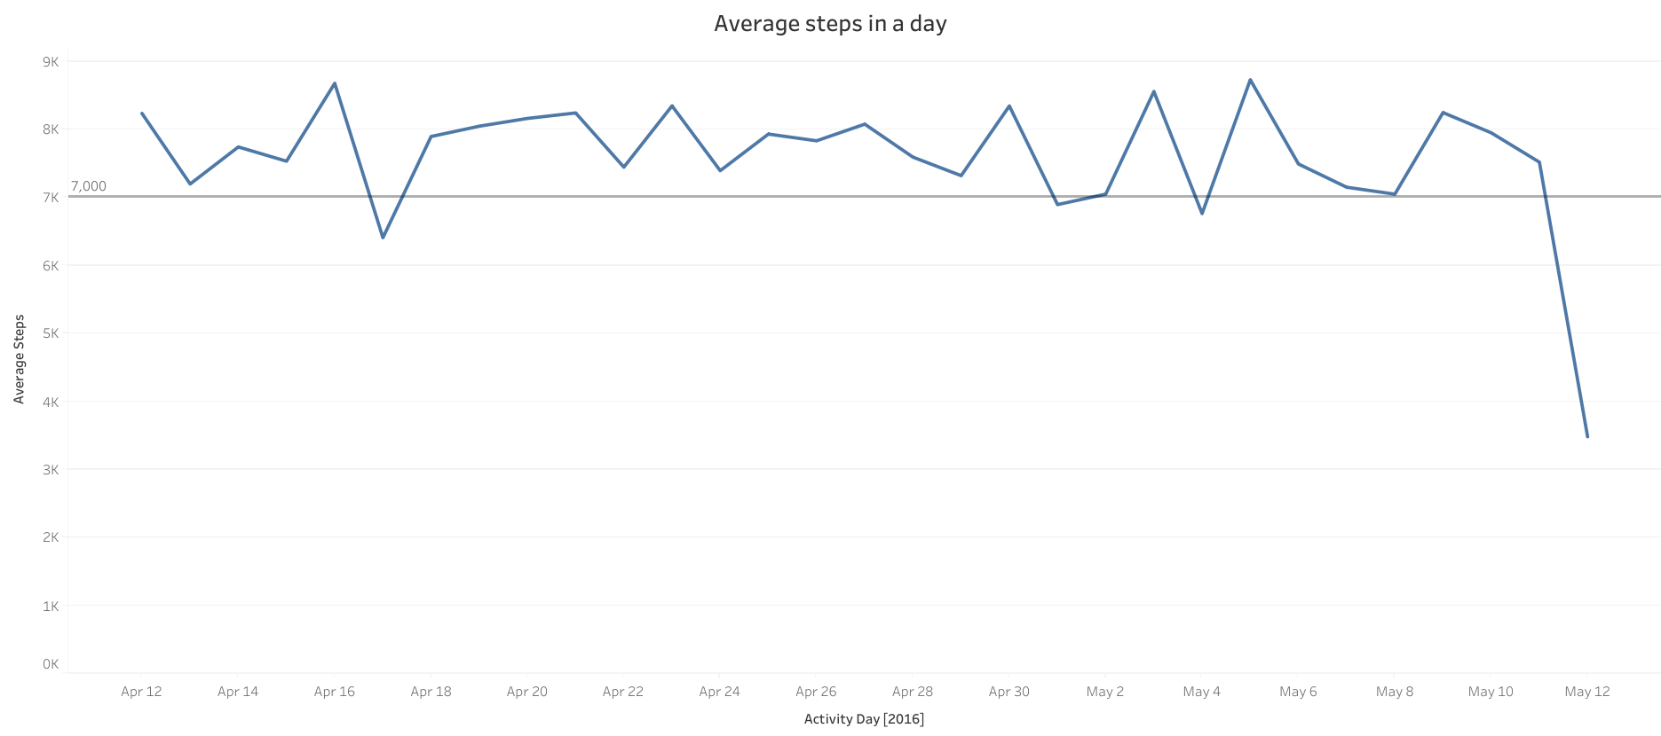
Project analysis slide 5
Data
Study
Trend
The above line graph depicts the average steps walked by individuals in a day
According to a study by Amanda Paluch in 2021 – middle-aged adults who completed 7000 steps per day had a 50-70% lower risk of coronary artery risk development.
A feature can be added to the Bellabeat app for daily steps target, similar to the calorie target.

Slide 7
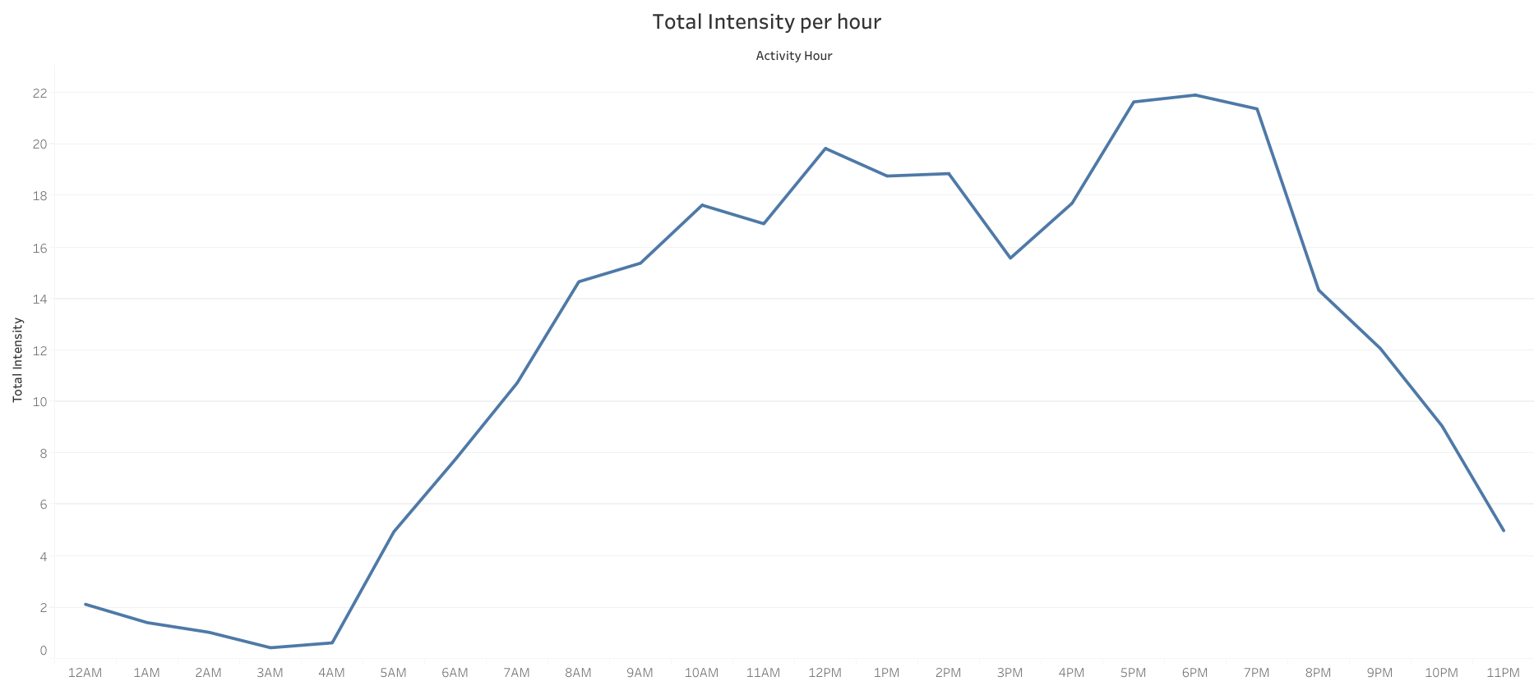
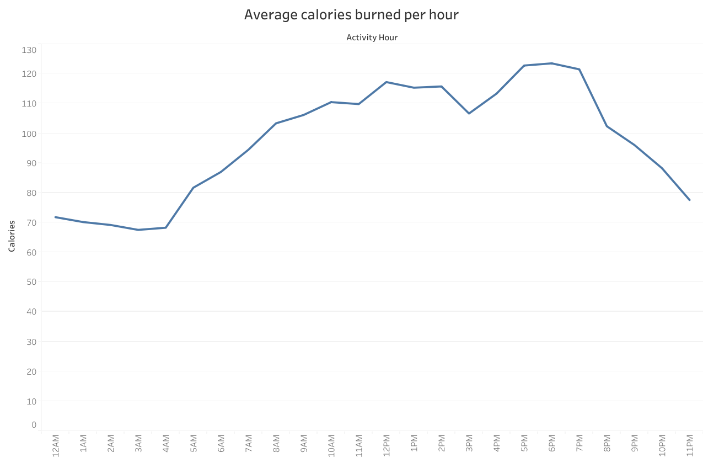
Project analysis slide 5
Data
Story
Trend
The above line graphs depict the total intensity and calories burned by individuals per hour
On an average, the individuals are active from 8 AM to 8 PM
Individuals are most active from 5 to 7 PM on an average.

Slide 8
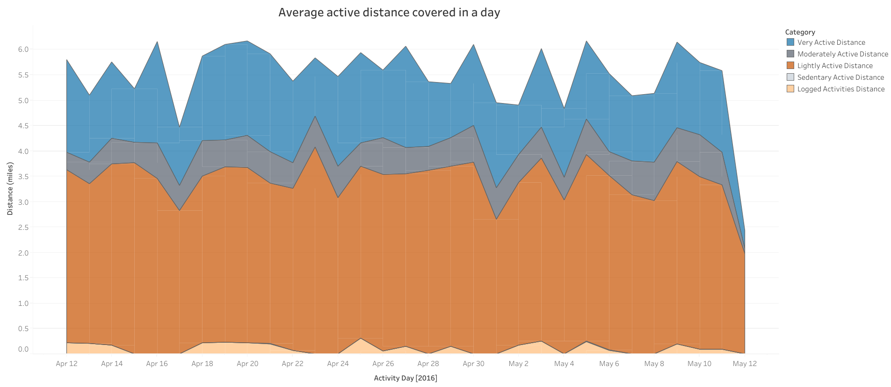
Project analysis slide 5
Data
Story
Trend
The above area chart depicts the average active distance covered by individuals in a day, sorted by intensity.
We can clearly see that ‘Lightly Active Distance’ takes up a large amount of distance covered by individuals, followed by ‘Very Active Distance’.
Individuals usually cover more light distance, usually when walking during work or household chores.

Slide 9
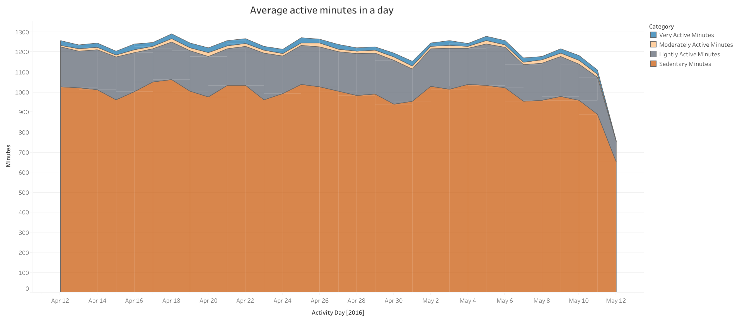
Project analysis slide 5
Data
Story
Trend
The above area chart depicts the average active minutes by individuals in a day, sorted by intensity.
We can clearly see that ‘Sedentary Minutes’ takes up a huge amount of active minutes by individuals, followed by ‘Lightly Active Minutes’.
Individuals usually spend majority of their time sedentary (working, sitting or sleeping), hence ‘Sedentary Minutes’ takes up for more than 50% of the total active minutes.

Slide 10
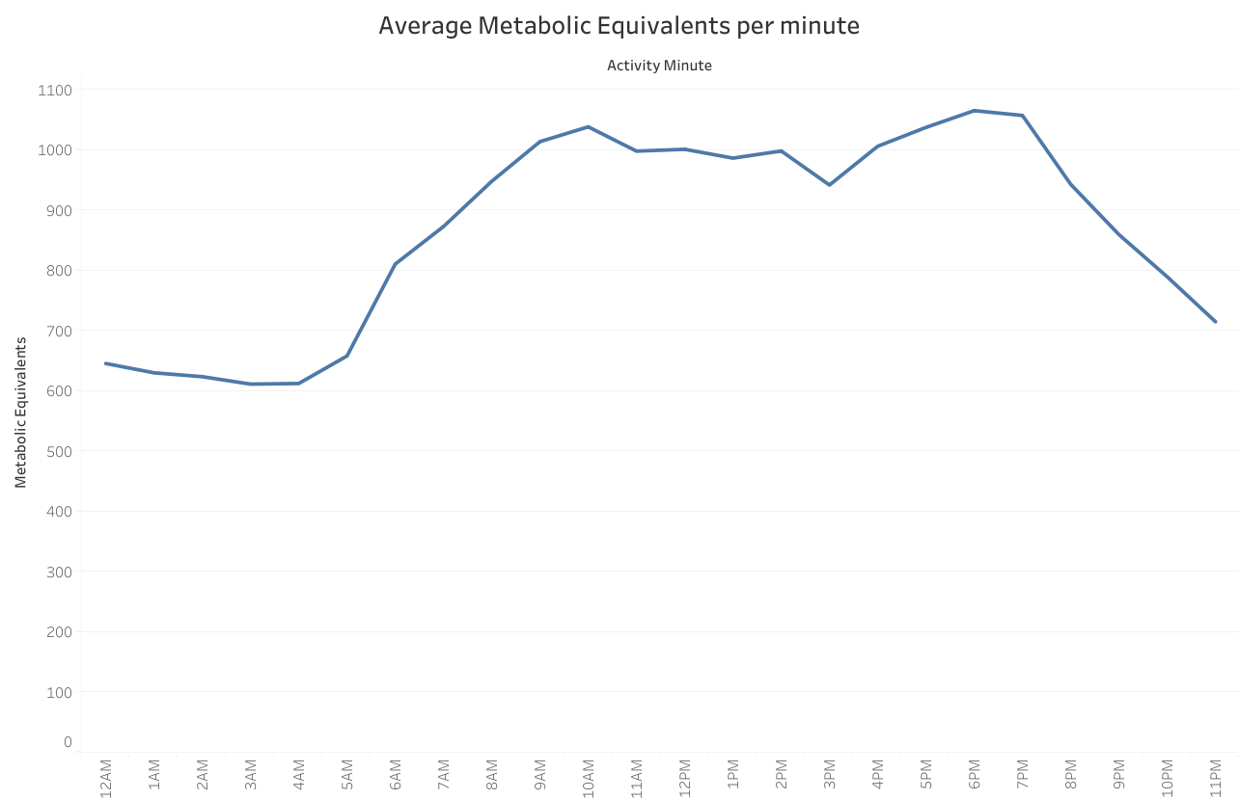
Project analysis slide 5
The Metabolic Equivalent of Task (MET) is the objective measure of the ratio of the rate at which a person expends energy, relative to the mass of that person, while performing some specific physical activity compared to a reference, currently set by convention at an absolute 3.5 mL of oxygen per kg per minute, which is the energy expended when sitting quietly by a reference individual, chosen to be roughly representative of the general population, and thereby suited to epidemiological surveys.
Data
Story
Trend
The above line graph depicts the average Metabolic Equivalent of Task per minute.
On an average, individuals have the highest METs between 9 to 11 AM and 6 to 7 PM.
METs are a great way to assess general fitness of an individual. We can add this feature to our product.

Slide 11
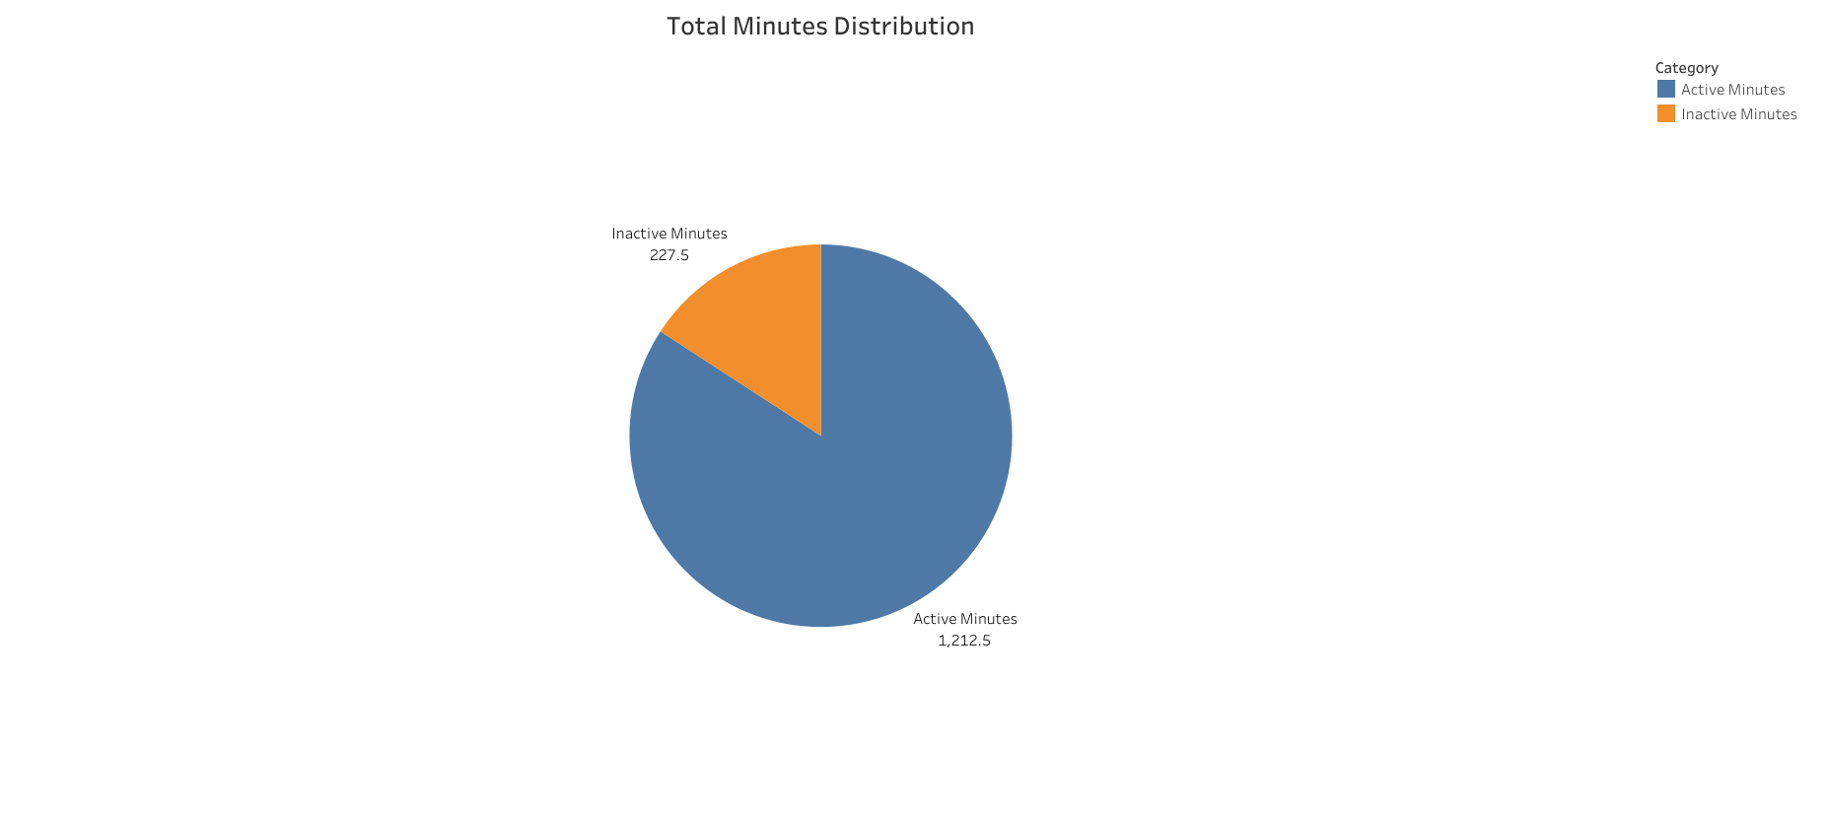
Project analysis slide 5
Data
Story
Trend
The above pie chart depicts the minutes distribution when the device was worn and when it was not worn.
We can clearly see that Active Minutes takes up 84.2% of the day whereas Inactive Minutes takes 15.8%.
On an average, 15.8% of the time, the device was not worn. Most probably when charging or not in use.

Slide 12
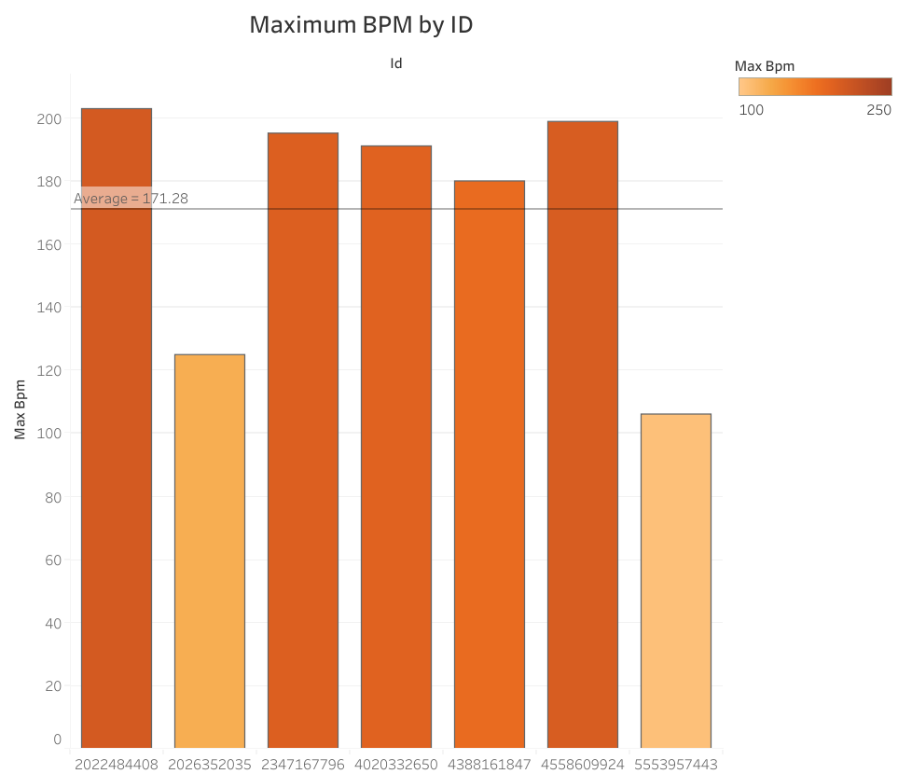
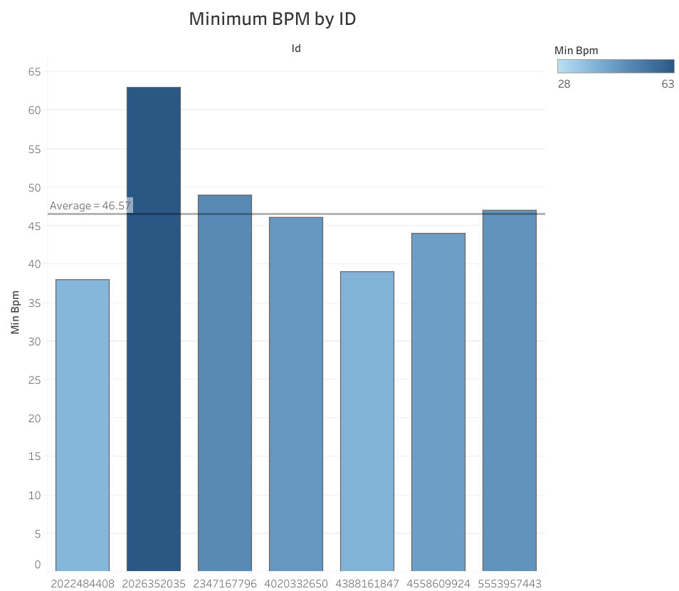
Project analysis slide 5
Data
Story
Trend
The above bar graphs depict the maximum and minimum heart-rates sorted by ID.
Average maximum heart-rate comes up at 171.28 bpm and average minimum heart-rate comes up at 46.57 bpm.
We can set alerts on the device for heart rates exceeding the upper and lower limits as per critical medical standards.

Slide 13
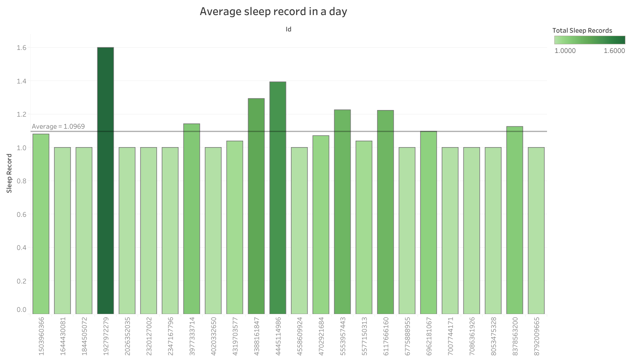
Project analysis slide 5
Data
Story
Trend
The above bar graph depicts the average sleep records in a day.
Most of the individuals tend to sleep only once a day.
On an average, an individual sleeps approximately 1.1 times a day.

Slide 14
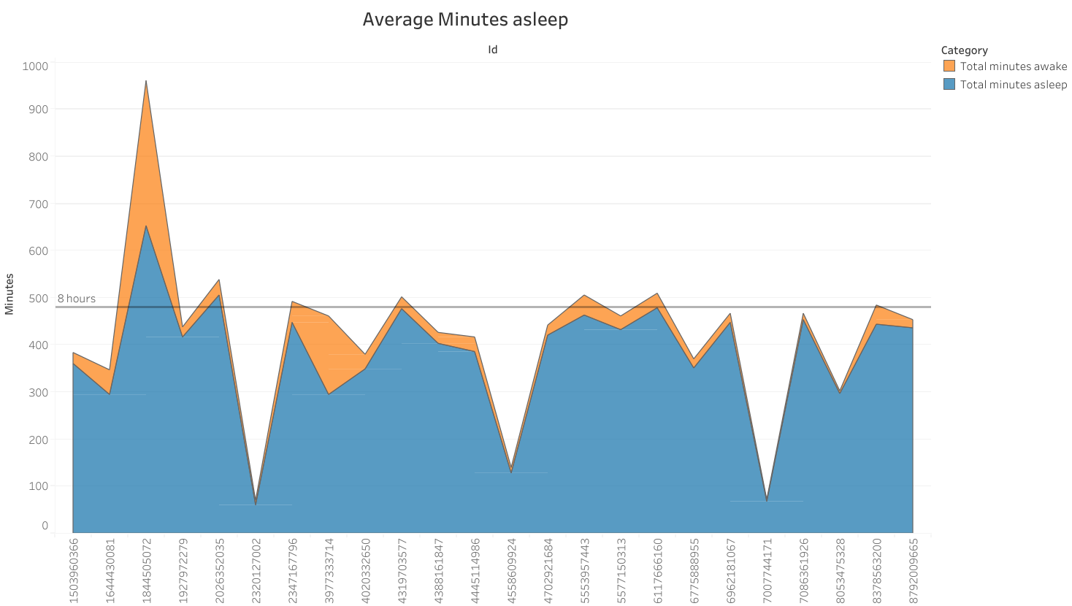
Project analysis slide 5
Data
Story
Trend
The above area chart depicts the average minutes an individual spends asleep in a day.
We can see most individuals are not getting 8 hours of sleep a day.
We can add features to let the individuals know the time spent asleep so that they can set targets appropriately.

Slide 15
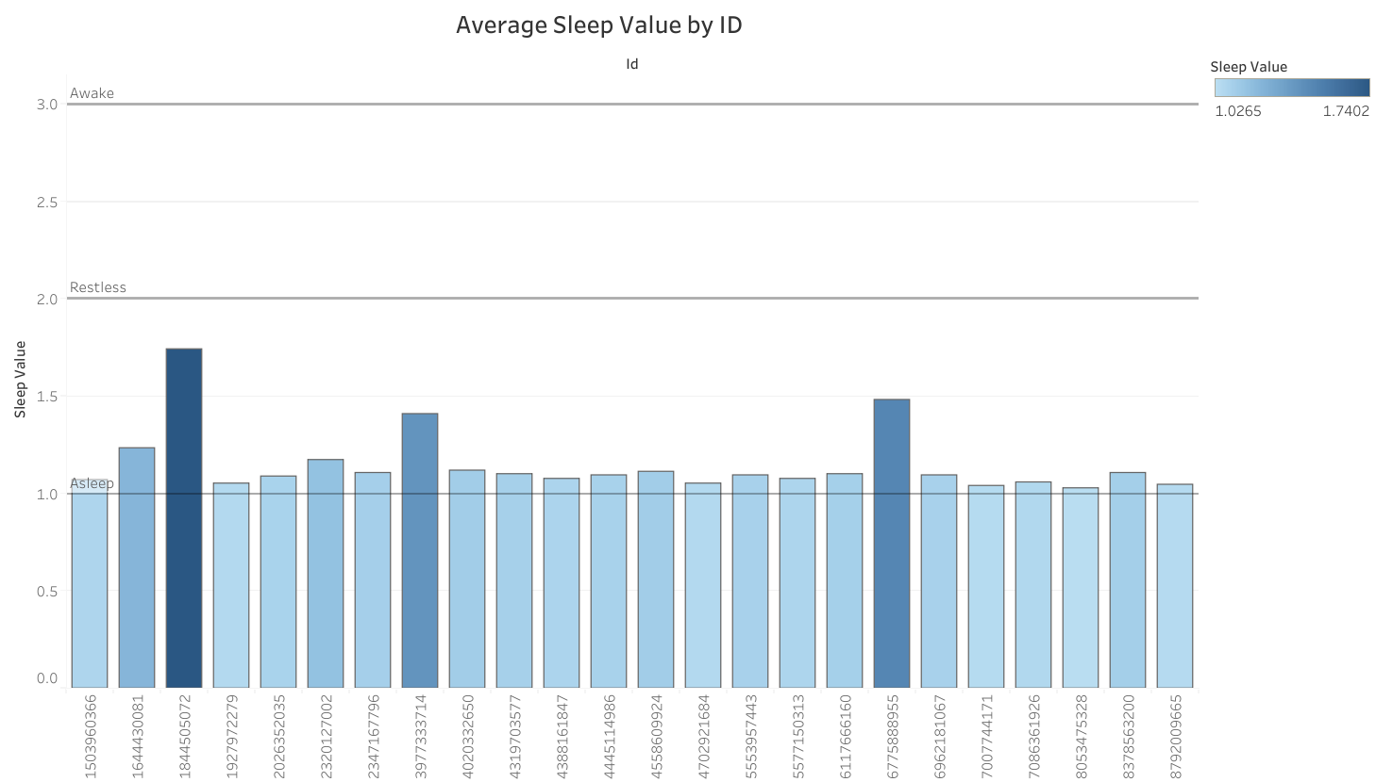
Project analysis slide 5
Data
Story
Trend
The above bar graph depicts the average sleep value of an individual during their time asleep.
Most individuals are in the asleep zone, when they are in bed, with minor exceptions.
Sleep value is important in determining the quality of sleep of an individual. We can add these features to our product for a comprehensive sleep calculation for our customers.

Slide 16
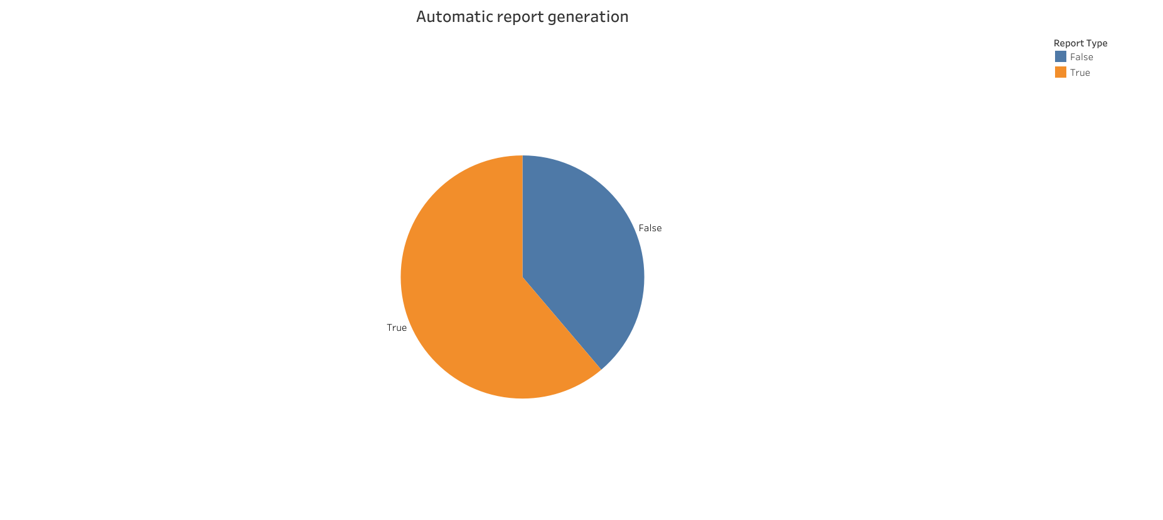
Project analysis slide 5
Data
Story
Trend
The above pie chart depicts whether the report generated was automatic (61.2%) or manual (38.8%)
The generated report contains metrics such as BMI, fat percentage and weight (in kg and pounds)
Users tend to generate manual reports in order to check their progress, but automatic reports are also a useful way to tracking progress. We shall include both options in our product for ease of use.

Slide 17
Project analysis slide 6
Conclusion
Data such as Active Distance and Active Minutes along with METs can be used to formulate an Active Score (out of 100) which will enable users develop a healthy routine.
We can include daily targets for parameters such as calories burned and steps. This will increase device/app interaction and help users track their data.
Inactive Minutes takes 15.8% of the time, mostly due to charging and when not in use. This won’t be an issue for Bellabeat Leaf as it needs battery replacement once every six months.
We should include an option for automatic report generation as 61.2% of the reports generated were automatic, which includes parameters such as BMI, fat percentage, weight, etc.
Health alerts can be issued via vibration or notification, when they exceed the critical health parameters of Heartrate (in BPM).
Data such as Sleep record per day, Sleep value and Minutes asleep can be used to formulate a Sleep Score (Rating) which will help users to have healthy sleeping habits.

Slide 18
Project analysis slide 10
APPENDIX
Fitness Tracker Market Share & Growth Analysis Report, 2028 (grandviewresearch.com)
Current Dietary Guidelines | health.gov
Steps per Day and All-Cause Mortality in Middle-aged Adults in the Coronary Artery Risk Development in Young Adults Study - PubMed (nih.gov)
Metabolic equivalents (METS) in exercise testing, exercise prescription, and evaluation of functional capacity - PubMed (nih.gov)
Target Heart Rate and Estimated Maximum Heart Rate | Physical Activity | CDC
(PDF) How Accurate Is Your Activity Tracker? A Comparative Study of Step Counts in Low-Intensity Physical Activities (researchgate.net)
Measuring Sleep Efficiency: What Should the Denominator Be? - PMC (nih.gov)

Slide 19
Thank You

